Slide 1

21ST CENTURY LITERATURE FROM THE PHILIPPINES AND THE WORLD
(Second Semester, FOURTH GRADING)

Slide 2
THE QUESTION OF RACE
LESSON # 4 (ESSAY)
“UNDER MY INVISIBLE UMBRELLA”
BY LAUREL FANTAUZZO

Slide 3
MARKER:
LIMINALITY
- IS A METAPHYSICAL STATE OF BEING NEITHER HERE NOR THERE.

Slide 4
ABOUT THE AUTHOR
LAUREL FANTAUZZO IS A FILIPINO- ITALIAN BY ETHNICITY BUT WAS BORN IN THE UNITED STATES AND HAS LIVED IN BROOKLYN AND LOWA.

Slide 5
SHE STUDIED CREATIVE WRITING AT THE UNIVERSITY OF LOWA, HOME OF THE MOST PRESTIGIOUS CREATIVE WRITING PROGRAMS IN THE WORLD.

Slide 6


Slide 7
IN THE CREATIVE NONFICTION ENTITLED “UNDER MY INVISIBLE UMBRELLA” WRITTEN BY LAUREL FANTAUZZO WHICH WON A 2ND PRIZE IN DON CARLOS -

Slide 8
PALANCA AWARD DURING THE YEAR 2013, SHOWCASES THE SOCIAL AND ECONOMIC ISSUES PRESENTED IN THE PHILIPPINES.

Slide 9
THE NONFICTION STORY WAS WRITTEN WHEN LAUREL AND HER MOTHER MOVED TO THE PHILIPPINES FOR A GREATER EXPERIENCE IN TEACHING ARTS AND LITERATURE.

Slide 10
THE ESSAY DISCUSSES THE AUTHOR’S STRUGGLES AND ADVANTAGES FACED IN HER
MOTHER’S COUNTRY, AS WELL AS THE PRIVILEGE FELT WHICH GIVES THE CHARACTER DISCOMFORT.

Slide 11
LAUREL FANTAUZZO, HERSELF EXPLAINS HOW AN INDIVIDUAL EXPERIENCES INEQUALITY BASED ON ONE’S SKIN COLOR IN THE PHILIPPINES.

Slide 12
COLORISM WHICH GIVES DIFFERENT TREATMENT AND ADVANTAGES TO A PERSON, WILL EITHER GIVE A BURDEN OR AN ENTITLEMENT.

Slide 13
HOWEVER, THIS ARE THE JUST A FEW OF THE ISSUES THAT ARE RAISED IN THE STORY.

Slide 14
IN THE LAST PART OF THE ESSAY, EVERYONE IS SOAKED IN THE RAIN AND THE AUTHOR DECLINES AN OFFER OF BEING SHELTERED BY A GUARD, -

Slide 15
HENCE, THIS REPRESENTS THE EQUALITY DESIRED BY THE AUTHOR WITH THE FILIPINOS AND THE WANTS TO BECOME ONE.

Slide 16


Slide 17
ACTIVITY # 4
PART 1
ANALYZE THE ESSAY OF LAUREL FANTAUZZO “UNDER MY INVISIBLE UMBRELLA”.

Slide 18
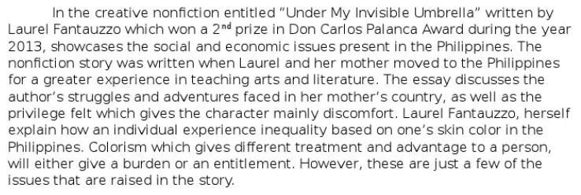

Slide 19
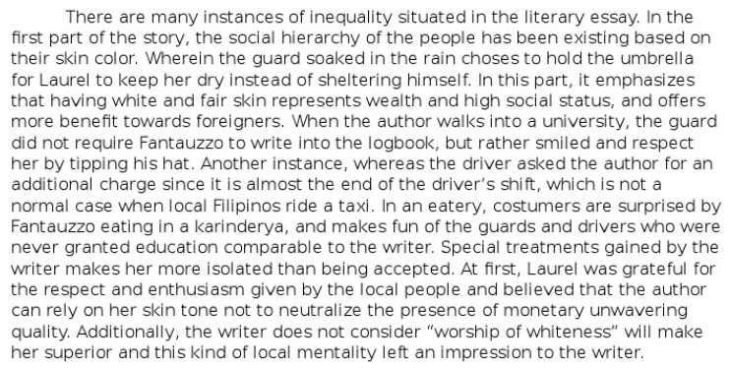

Slide 20
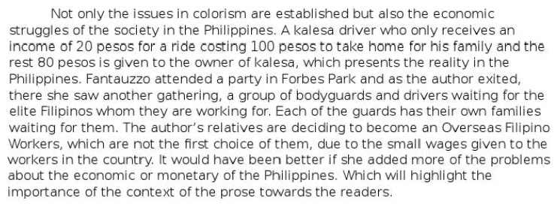

Slide 21
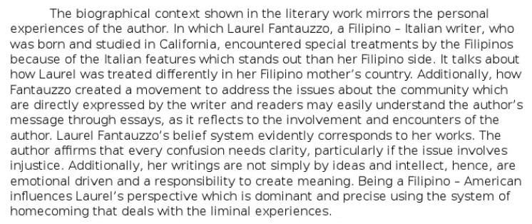

Slide 22
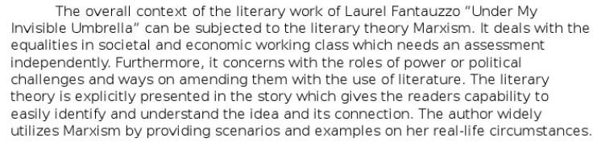

Slide 23
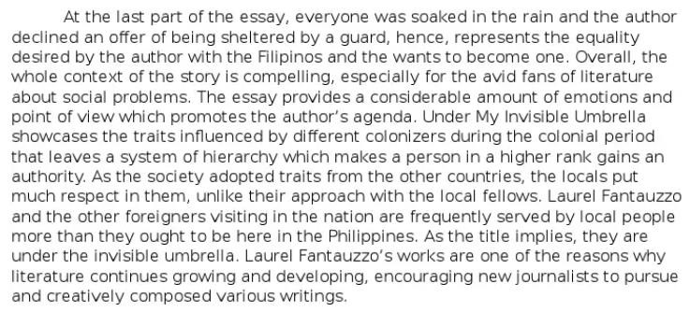

Slide 24
PART 2
WHAT HAVE YOU LEARNED IN THE ESSAY “UNDER MY INVISIBLE UMBRELLA” BY LAUREL FANTAUZZO?

Slide 25
ASSIGNMENT # 4
READ AND ANALYZE THE ESSAY “A SONG OF TWO CITIES” BY LAWRENCE L. YPIL.

